Slide 1


Power analysis: how many participants do you need?
Dr Andy Fugard
Intermediate Quantitative Social Research
5 Feb 2018
a.fugard@bbk.ac.uk

Slide 2
15-Jan-18 | Multilevel modelling, a.k.a. mixed effects modelling | Linear mixed effects models (LMMs)
22-Jan-18 | LMM diagnostics and complications with times series data | LMMs continued
29-Jan-18 | Generalised linear mixed effects models (GLMMs) | GLMMs
05-Feb-18 | Power analysis: How many participants do you need? | Power analysis for t-tests and correlation, which can be seen as types of regression, and LMMs
12-Feb-18 | Reading Week
19-Feb-18 | Workshop Week
26-Feb-18 | Latent variable models I | Exploratory factor analysis
05-Mar-18 | Latent variable models II | Confirmatory factor analysis
12-Mar-18 | Revision session

Slide 3
Reminder of distinction between sample and population

Slide 4















Slide 5









Slide 7
You know something about a random sample

Slide 8
What can you say about the population that sample is from?

Slide 9
You could have had a few different samples…

Slide 10
You could have had a few different samples…

Slide 11
You could have had a few different samples…

Slide 12
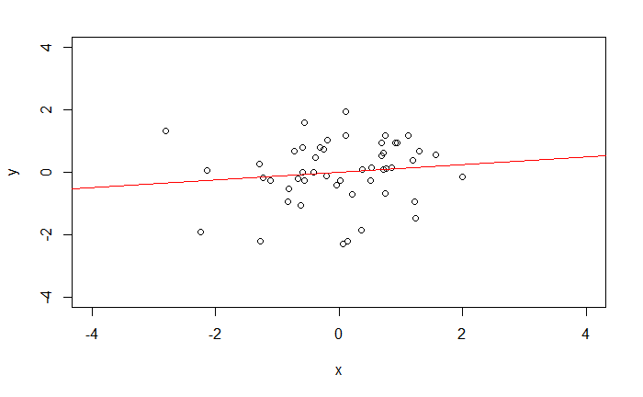
A sample

Slide 13
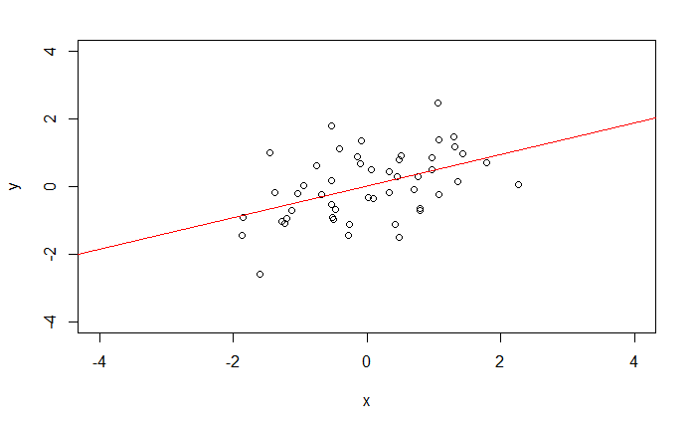
Another sample from the same population

Slide 14
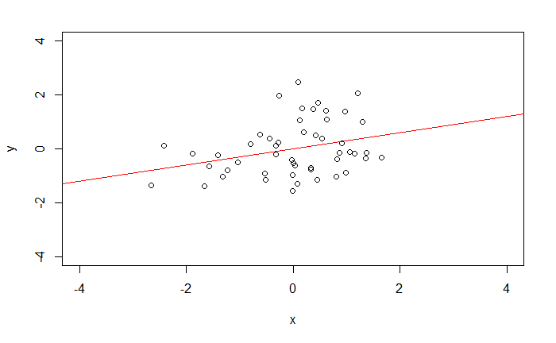
And another

Slide 15
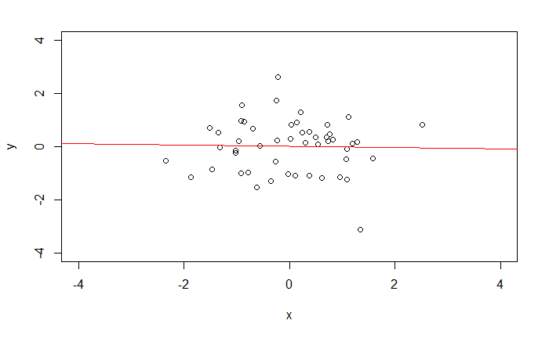
And another…

Slide 16
So what…?
Effects you find in your sample, e.g.,
slopes
intercepts
probably differ from those in the population
p-values, standard error, confidence intervals help you think about uncertainty

Slide 17
The next slide uses analogy and a pretty picture of a galaxy to convey the essence of power analysis

Slide 18
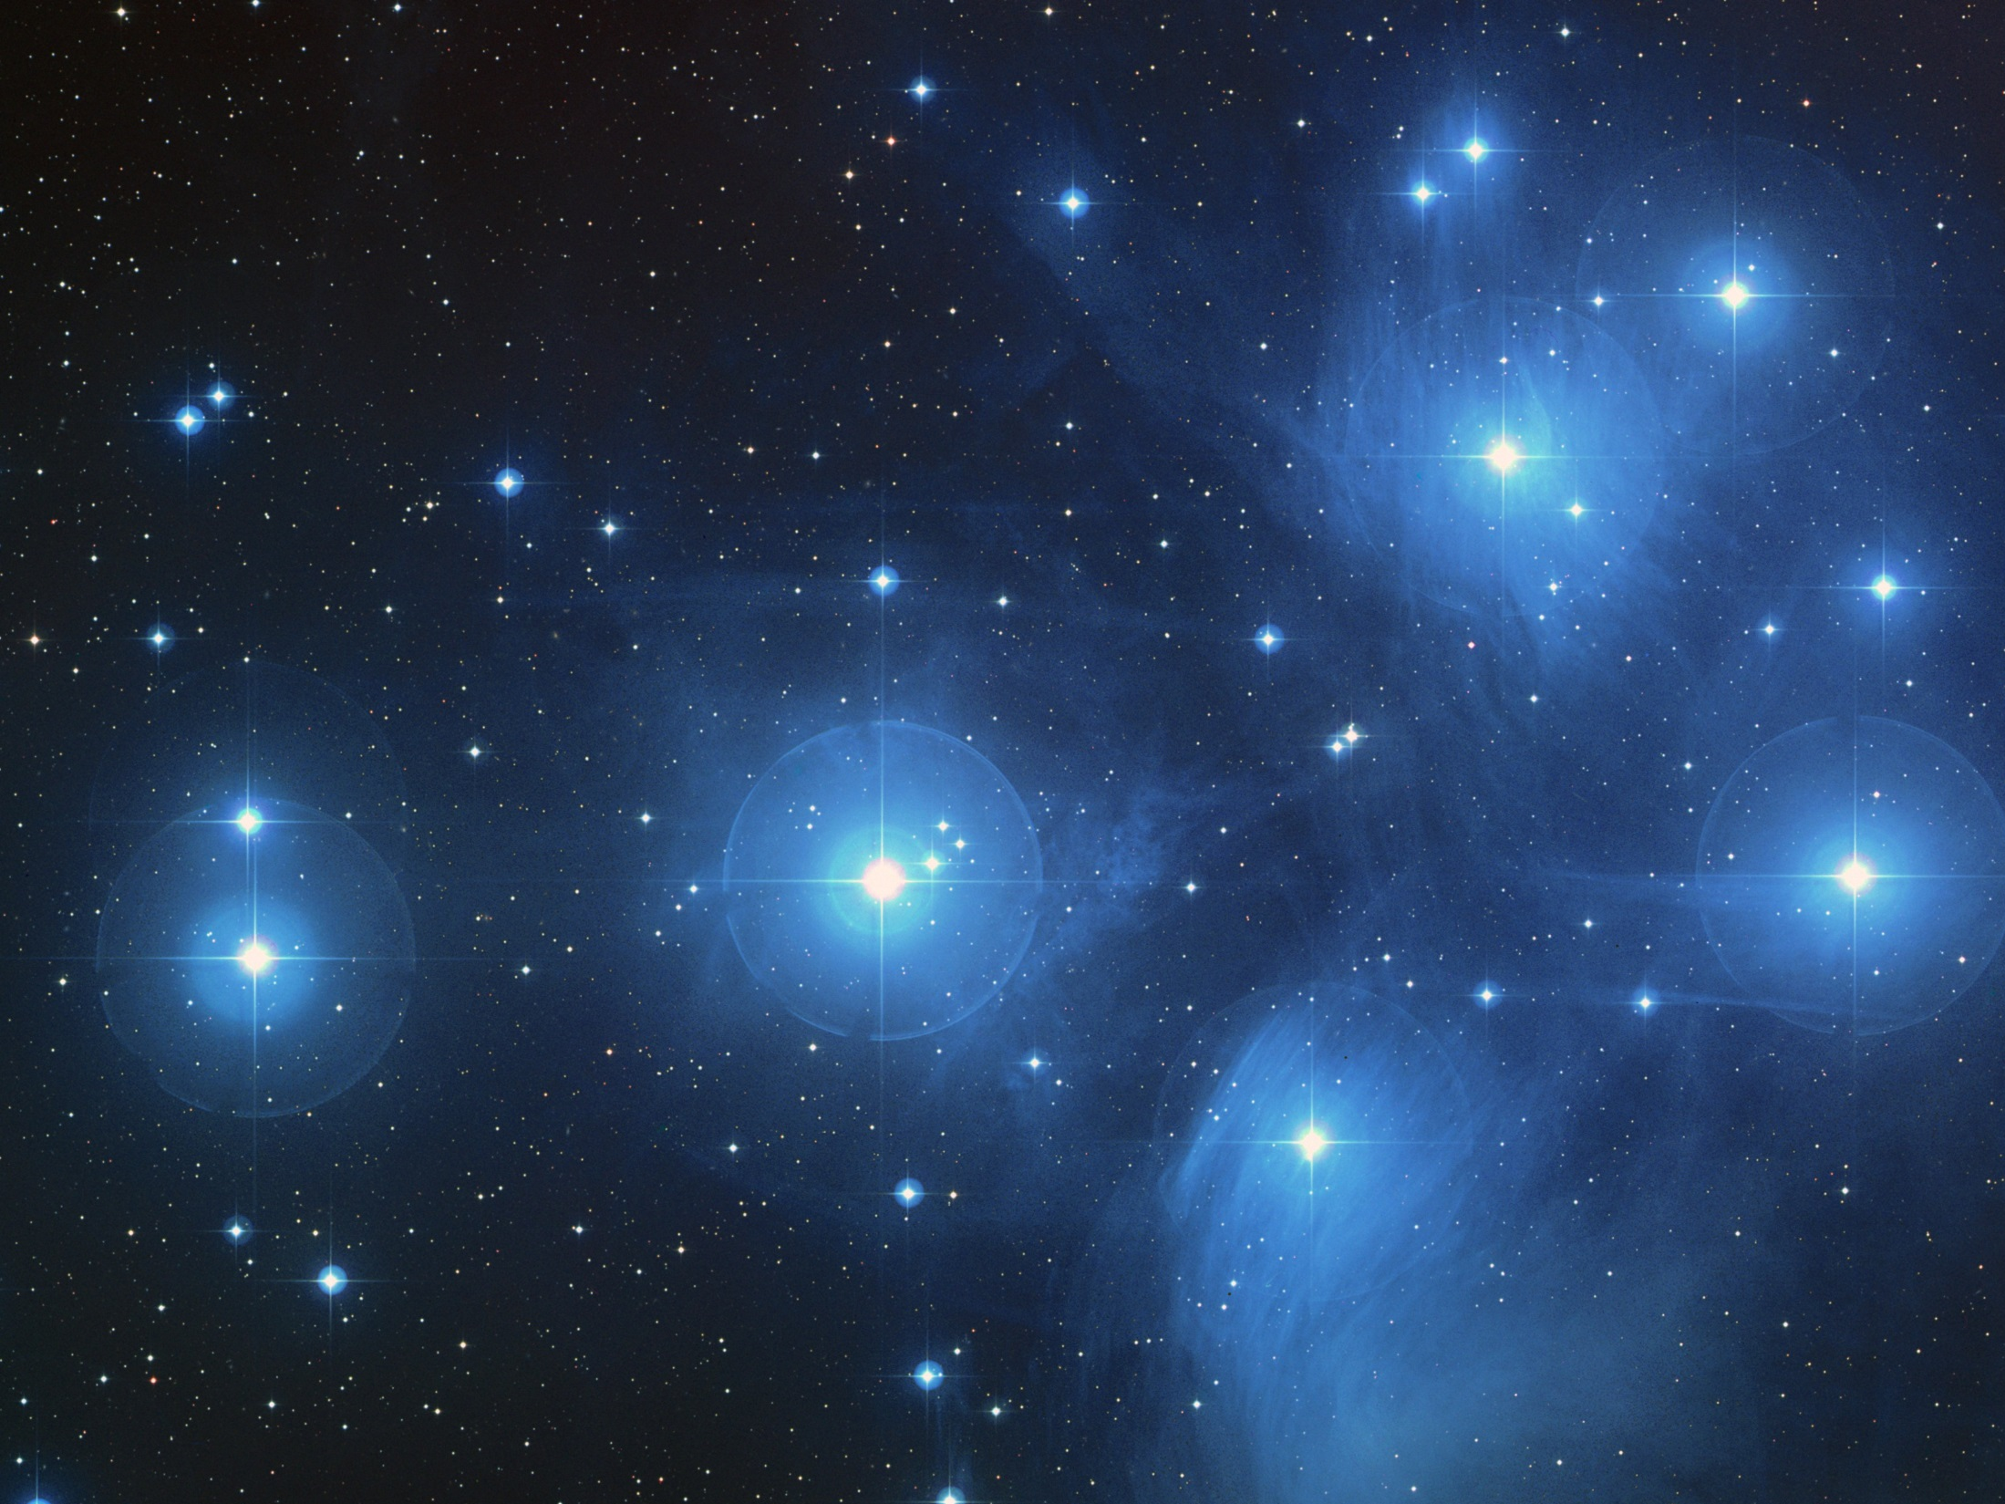
“An astronomer does not know the magnitude of new stars until she has found them, but the magnitude of star she is looking for determines how much she has to spend on a telescope.”
Senn, S. J. (2002)
BMJ, 325, 1304–1304

Slide 19
Power analysis: how to choose a sample size
Requires articulating your assumptions
about the magnitude of an effect that’s…
… likely to exist
(e.g., based on similar prior work)
… practically meaningful
(don’t waste time/money on tiny effects)

Slide 20
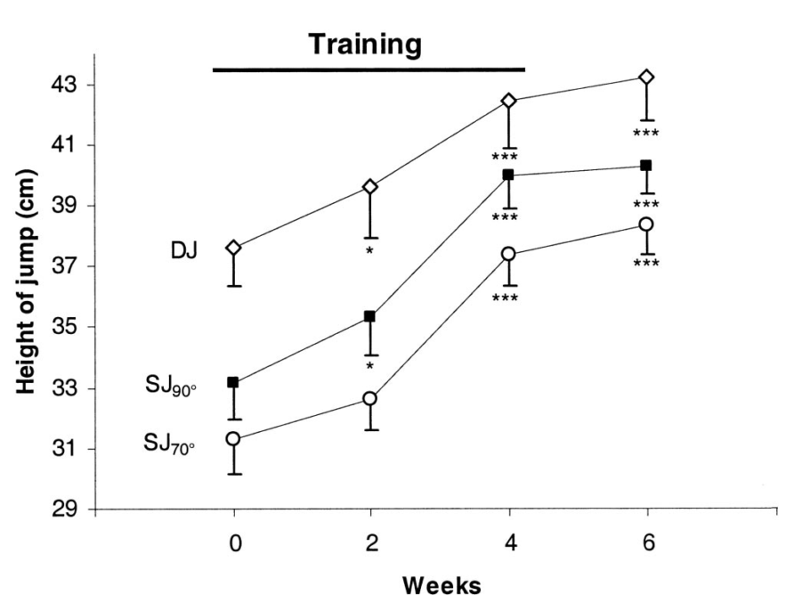
(Made up) example of a simple effect size: effect of mindfulness training on vertical jump height
Notes:
Graph (for another intervention) from Maffiuletti et al (2002)

Slide 21
Hang on
I’m running a new study…
I need to choose an effect size…
to decide my sample size
But… if I knew the effect size already, then surely I wouldn’t need to run a new study?!

Slide 22
Power
How sure you are that you will get a statistically significant result, if there is an effect of a particular magnitude to be found.
This is called “power”
Common to aim for 80%. This means that if loads of studies were run, sampling from the same population, then 80% of them would be statistically significant if the effect is there.

Slide 23
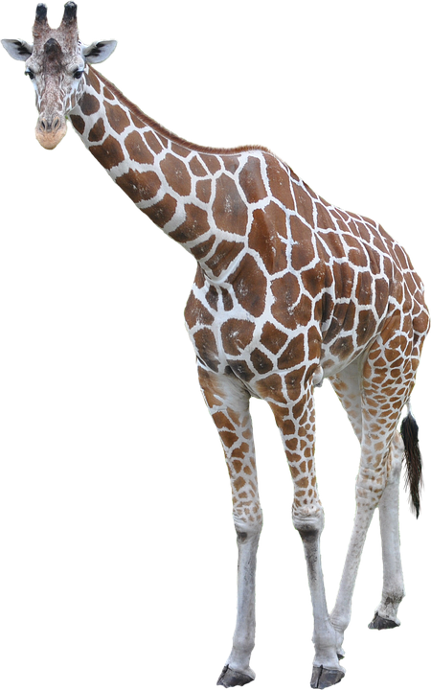
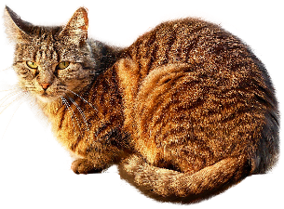
Building intuitions
Think about mean height differences
Some differences are obvious; you don’t need many examples to spot them
Are giraffes taller than cats on average?

Slide 24
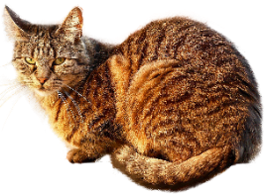
Are cats’ names correlated with their height? Maybe subtler. More cats needed.

Slide 25
More intuition building

Slide 26
Let’s try studies with N = 20 when the association is small

Slide 27
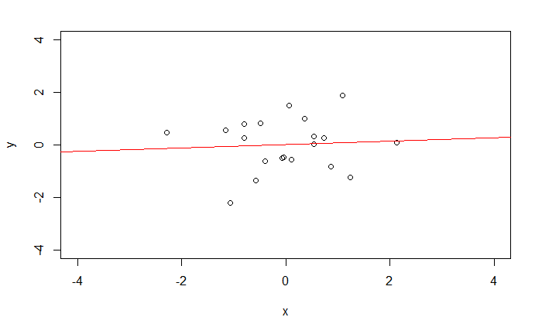

Slide 28
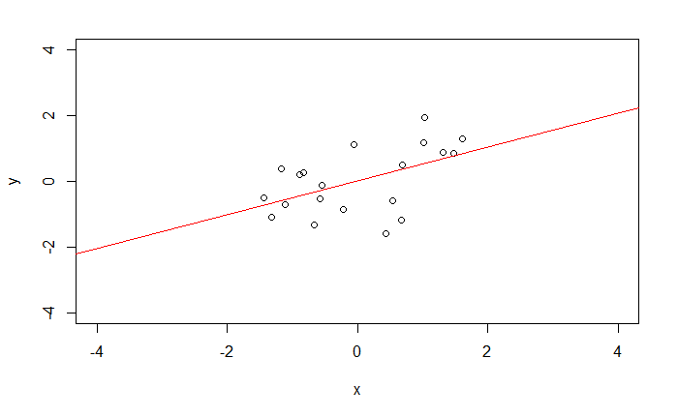

Slide 29
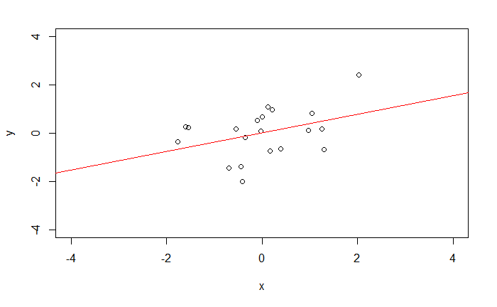

Slide 30
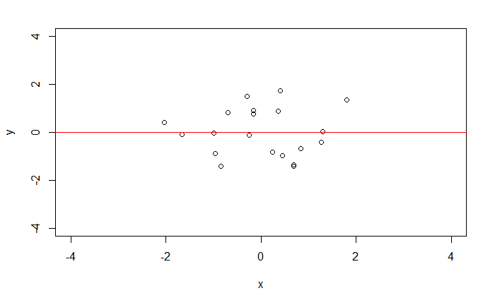

Slide 31
Run a huge study with 10000

Slide 32
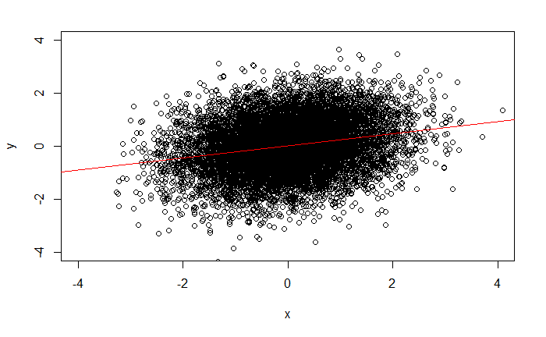
Somewhat easier to see now…?

Slide 33
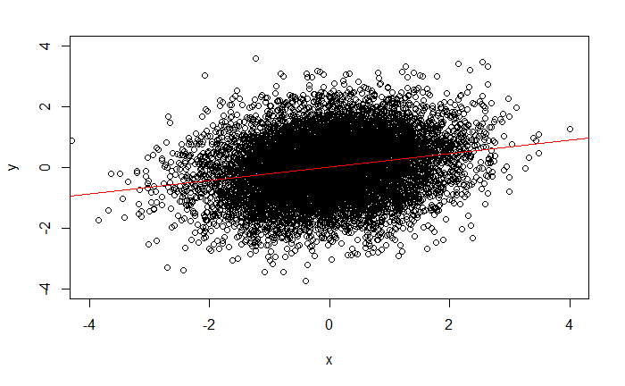
Somewhat easier to see now…?

Slide 34
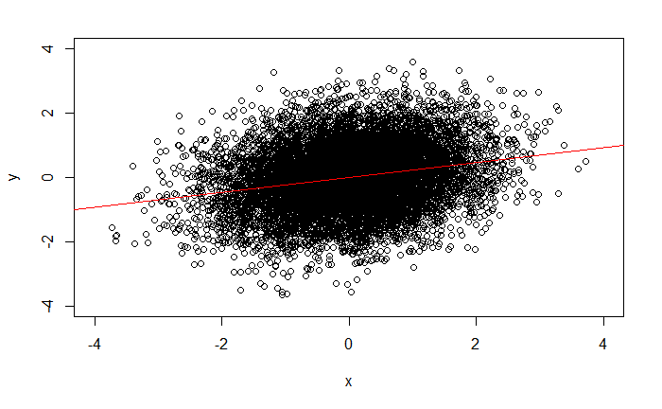
Somewhat easier to see now…?

Slide 35
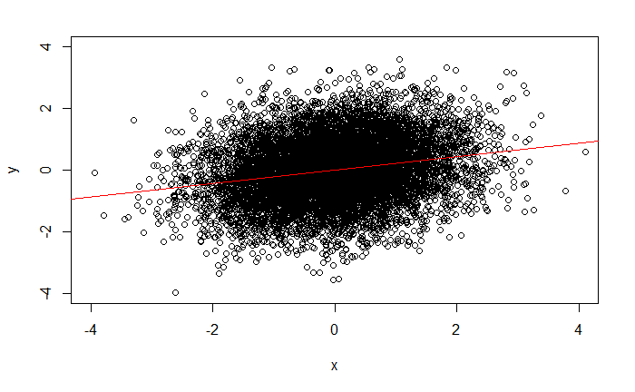
Somewhat easier to see now…?

Slide 36
Let’s try studies with N = 20 when the association is HUGE

Slide 37
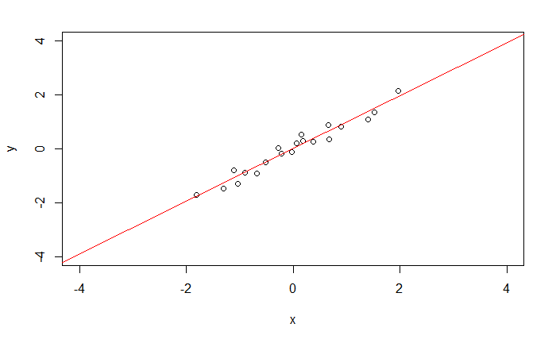

Slide 38
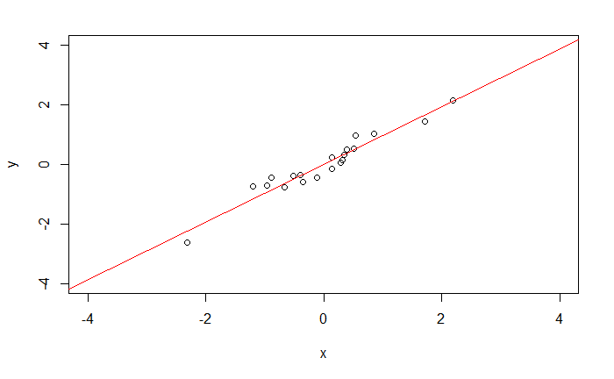

Slide 39
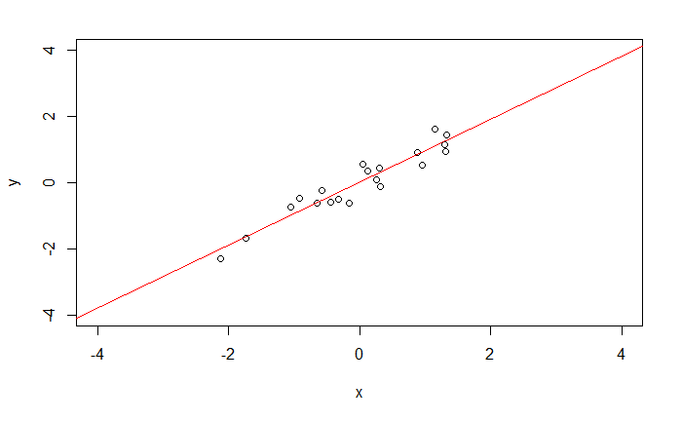

Slide 40
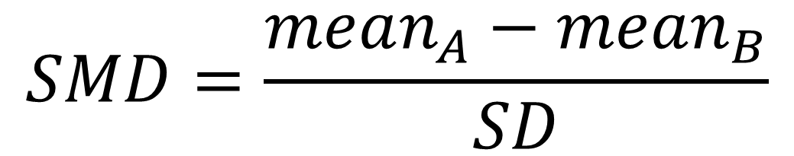
Standardised mean difference (SMD), also known as Cohen’s d
Difference in means
$$SMD=\frac{mean_{A}−mean_{B}}{SD}$$

Slide 41
Standardised mean difference (SMD), also known as Cohen’s d
$$SMD=\frac{mean_{A}−mean_{B}}{SD}$$
Divided by a standard deviation, e.g., the pooled SD of the two groups

Slide 42
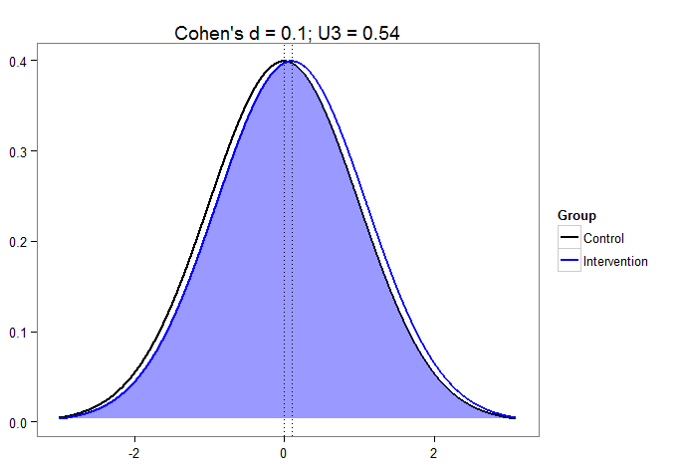

Slide 43
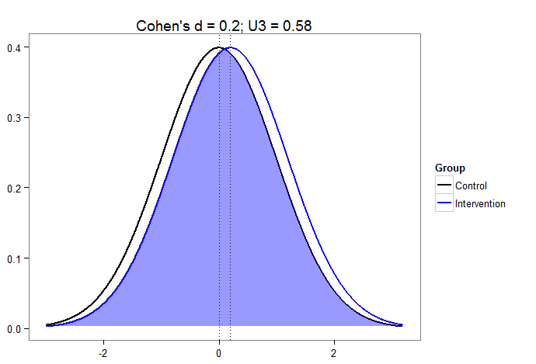
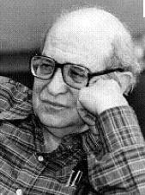
small

Slide 44
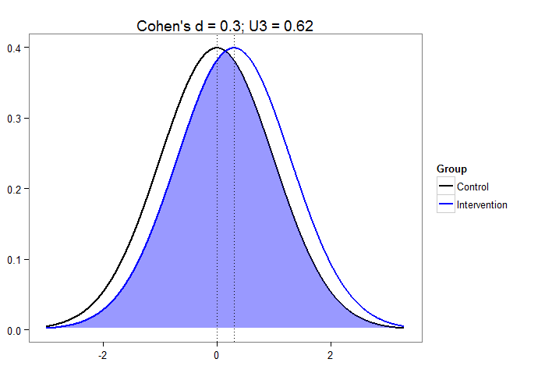

Slide 45


Slide 46
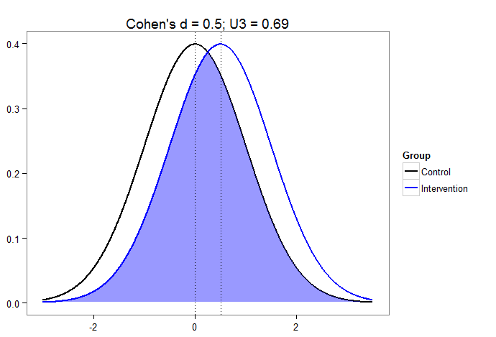
medium

Slide 47
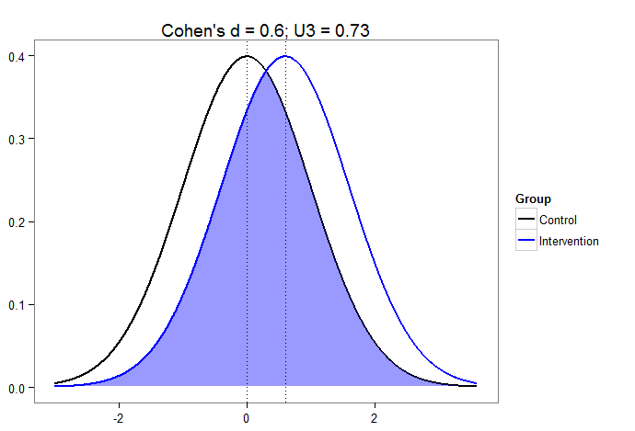

Slide 48


Slide 49
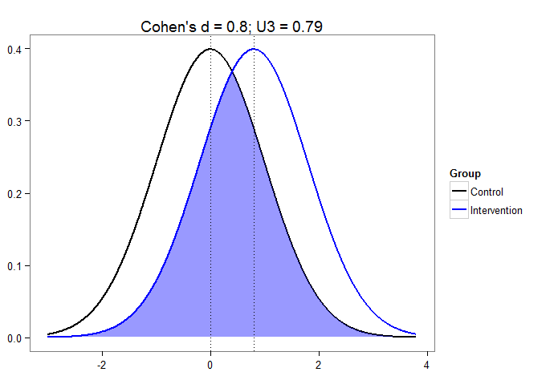
LARGE!

Slide 50
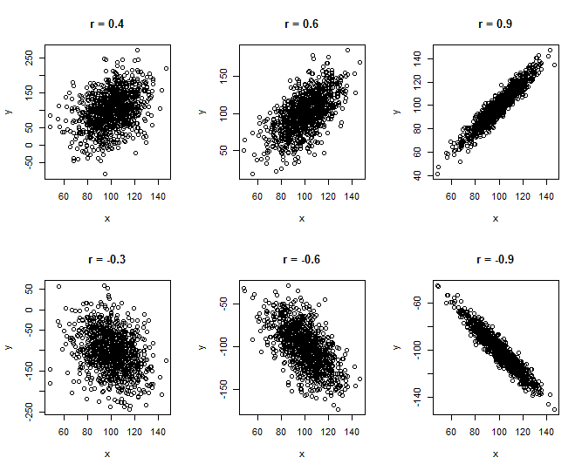
Another standardised effect size: r

Slide 51
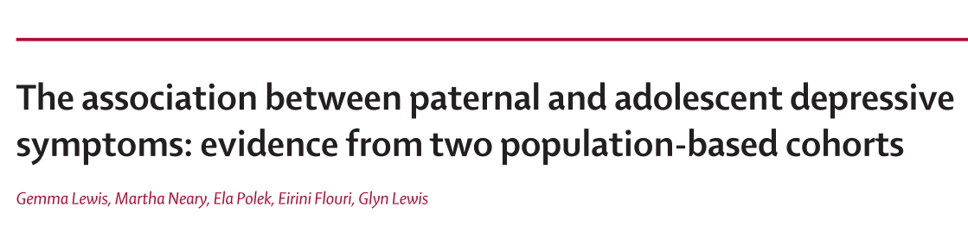

Abstract: After all adjustments, a 1 SD (three-point) increase in paternal depressive symptoms was associated with an increase of 0·24 SMFQ points (95% CI 0·03–0·45; p=0·023)…

Slide 52
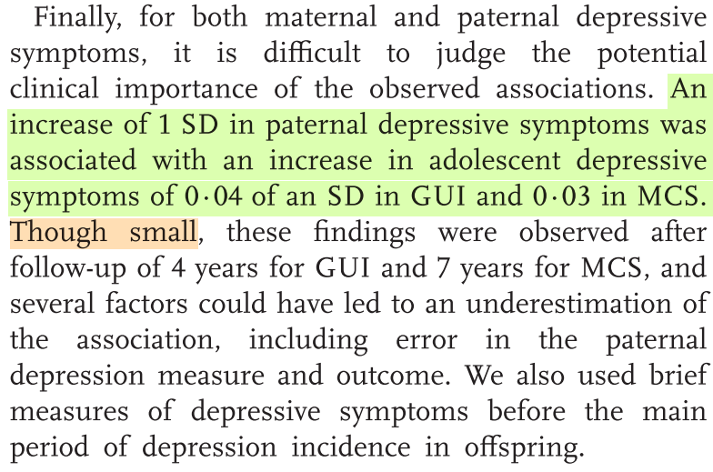
At the end of discussion – clearer…

Slide 53
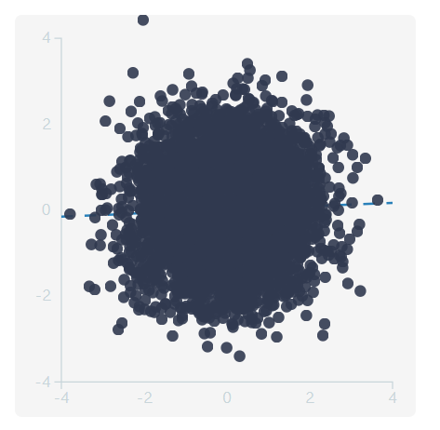
Visualisation using simulated data Made with http://rpsychologist.com/d3/correlation/
Child depressive symptoms
Parental depression

Slide 54
Two flavours of analysis we will explore
Testing for a difference in means between two groups (difference in SD units, Cohen’s d)
Testing for an association between two variables (in SD units, Pearson’s r)
Both are special cases of regression

Slide 55
Going further
You can do power analysis for more complex models using simulation
Generate random data, e.g., using rnorm, with the true parameters reflecting your assumptions
Fit a statistical model and note whether your key predictor of interest was statistically significant
(Ask R to!) repeat this 1000 times (or more)
Count proportion of statistically significant results (the power)

Slide 56

Homework: Watch Black Mirror (S4E4), Hang the DJ, and think about how they define 99.8% match
Pic: JONATHAN PRIME/NETFLIX

Slide 57


Slide 58
The end

